Slide 1
RNN Architecture
Instructor: Dr. Yan Yan

Slide 2
Recurrent Neural Network (RNN)
The output of hidden layer are stored in the memory.
store
Memory can be considered as another input.

Slide 3

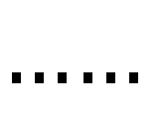
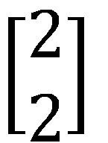
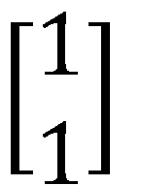
Example
Input sequence:
$$\left[\begin{aligned}1 \\ 1\end{aligned}\right]$$
$$\left[\begin{aligned}1 \\ 1\end{aligned}\right]$$
$$\left[\begin{aligned}2 \\ 2\end{aligned}\right]$$
$$……$$
output sequence:
$$\left[\begin{aligned}4 \\ 4\end{aligned}\right]$$
4
4
store
2
2
given Initial values
0
0
All the weights are “1”, no bias
1
1
All activation functions are linear

Slide 4
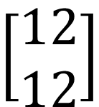
Example
Input sequence:
$$\left[\begin{aligned}1 \\ 1\end{aligned}\right]$$
$$\left[\begin{aligned}1 \\ 1\end{aligned}\right]$$
$$\left[\begin{aligned}2 \\ 2\end{aligned}\right]$$
$$……$$
output sequence:
$$\left[\begin{aligned}4 \\ 4\end{aligned}\right]$$
$$\left[\begin{aligned}12 \\ 12\end{aligned}\right]$$
12
12
store
6
6
2
2
All the weights are “1”, no bias
1
1
All activation functions are linear

Slide 5
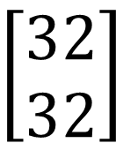
Example
Input sequence:
$$\left[\begin{aligned}1 \\ 1\end{aligned}\right]$$
$$\left[\begin{aligned}1 \\ 1\end{aligned}\right]$$
$$\left[\begin{aligned}2 \\ 2\end{aligned}\right]$$
$$……$$
output sequence:
$$\left[\begin{aligned}4 \\ 4\end{aligned}\right]$$
$$\left[\begin{aligned}12 \\ 12\end{aligned}\right]$$
$$\left[\begin{aligned}32 \\ 32\end{aligned}\right]$$
32
32
store
Changing the sequence order will change the output.
16
16
6
6
All the weights are “1”, no bias
2
2
All activation functions are linear

Slide 6

RNN
The same network is used again and again.
Probability of “arrive” in each slot
Probability of “Taipei” in each slot
Probability of “on” in each slot
y¹
y²
y³
store
store
a¹
a²
a³
a¹
a²
x¹
x²
x³
arrive Taipei on November 2nd

Slide 7
RNN
Different
Prob of “leave” in each slot
Prob of “Taipei” in each slot
Prob of “arrive” in each slot
Prob of “Taipei” in each slot
y²
……
y²
……
y¹
y¹
store
store
a¹
a²
a¹
a²
a¹
……
a¹
……
x¹
x²
……
x¹
x²
……
leave
Taipei
arrive
Taipei
The values stored in the memory is different.
Notes:
The same input can have totoally different output.

Slide 8
Of course it can be deep …
y^{t}
y^{t+1}
y^{t+2}
……
……
……
……
……
……
……
……
……
x^{t}
x^{t+1}
x^{t+2}

Slide 9
Elman Network & Jordan Network
Elman Network
Jordan Network
y^{t}
y^{t+1}
y^{t}
y^{t+1}
W^{h}
Wº
Wº
Wº
Wº
……
……
……
……
W^{h}
W^{i}
W^{i}
W^{i}
W^{i}
x^{t}
x^{t+1}
x^{t}
x^{t+1}

Slide 10
Bidirectional RNN
……
x^{t}
x^{t+1}
x^{t+2}
……
y^{t}
y^{t+1}
y^{t+2}
……
……
x^{t}
x^{t+1}
x^{t+2}

